Slide 1



DESIGNING PERSISTENT PATHS TO SUSTAIN Wireless Sensor Networks Srikanth K. V. Sudarshan Electrical and Computer Engineering University of Houston
Advance Digital Control Systems
Final-Project Presentation

Slide 2
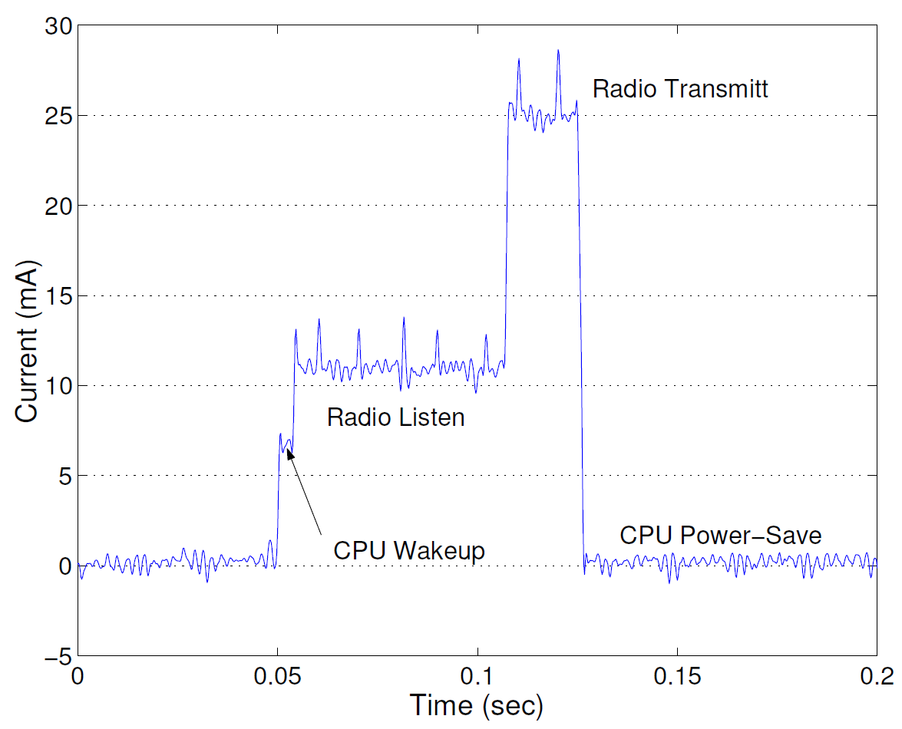
Problem : Wireless Sensor Networks need Energy
Some WSN should last for decades, but traditional disposable batteries cannot sustain such a network (Structure-monitoring, Healthcare, Military, Subsea…)
Max energy consumed by wireless transmissions
Reduce Energy: low power Hardware, Low Energy Adaptive Clustering Hierarchy (LEACH),…
Harvest Energy: wind, solar, thermal,…
More Energy: bigger batteries, more batteries, redundant nodes,…

Slide 3





Servicing WSN with UVs
10101…
10101…
10101…
10101…
10101…
10101…
r_{recharge}
r_{data}
Traditional WSN
Dynamic path-planning
We present a path-planning and path optimization algorithms for sustaining WSNs
Robots replenish energy
Robots collect sensed information (cut data transmissions from long to short-distances)

Slide 4
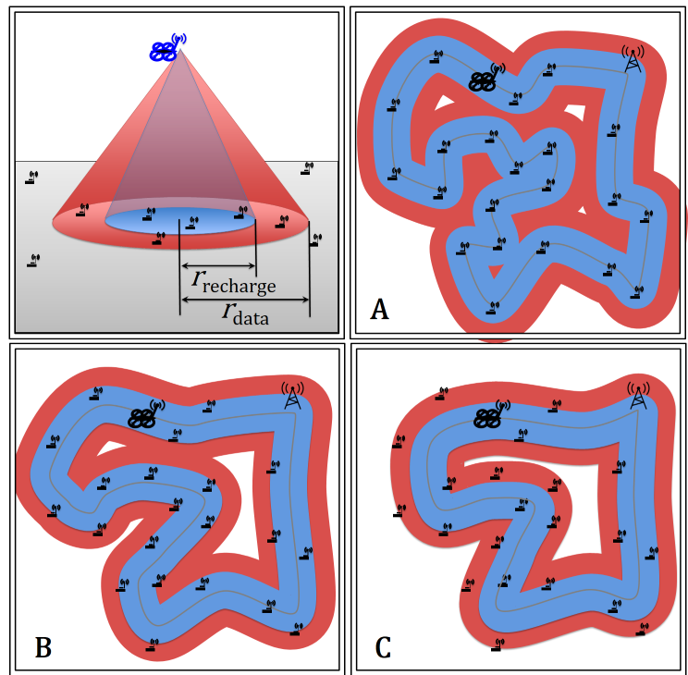

Overview
Optimized path-planning for sustaining a WSN with two algorithms:
Gradient descent on cost function (local minima)
mTSP solver (searches for better rearrangements)
A- Path visits every sensor node
B- Path charges every sensor node, depends on $r_{data}$
C- Path collects data from every sensor node, dependents on $r_{recharge}$

Slide 5
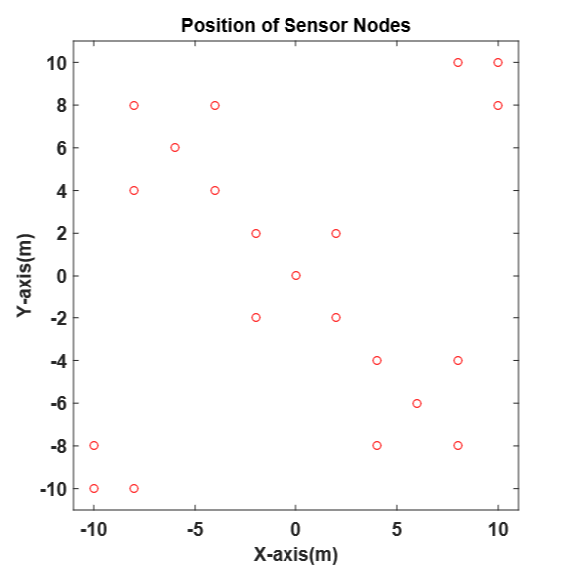
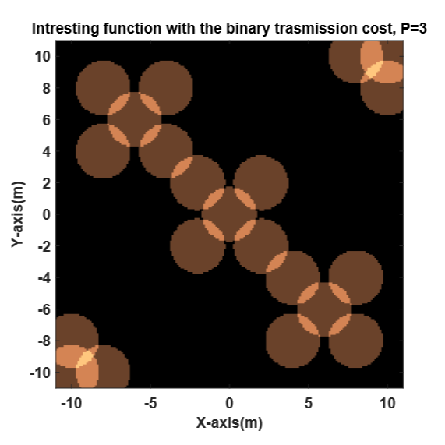

Key Insight: The UV’s Footprint
$$k_{footprint}=\frac{2}{N^{2}−N}\sum_{i}^{N}{{\sum_{j=i+1}^{N}{{{||p}_{i}{−p}_{j}||}_{2}≤}r}_{footprint} }$$
Location of the sensor nodes on a map
Sensor footprint

Slide 6
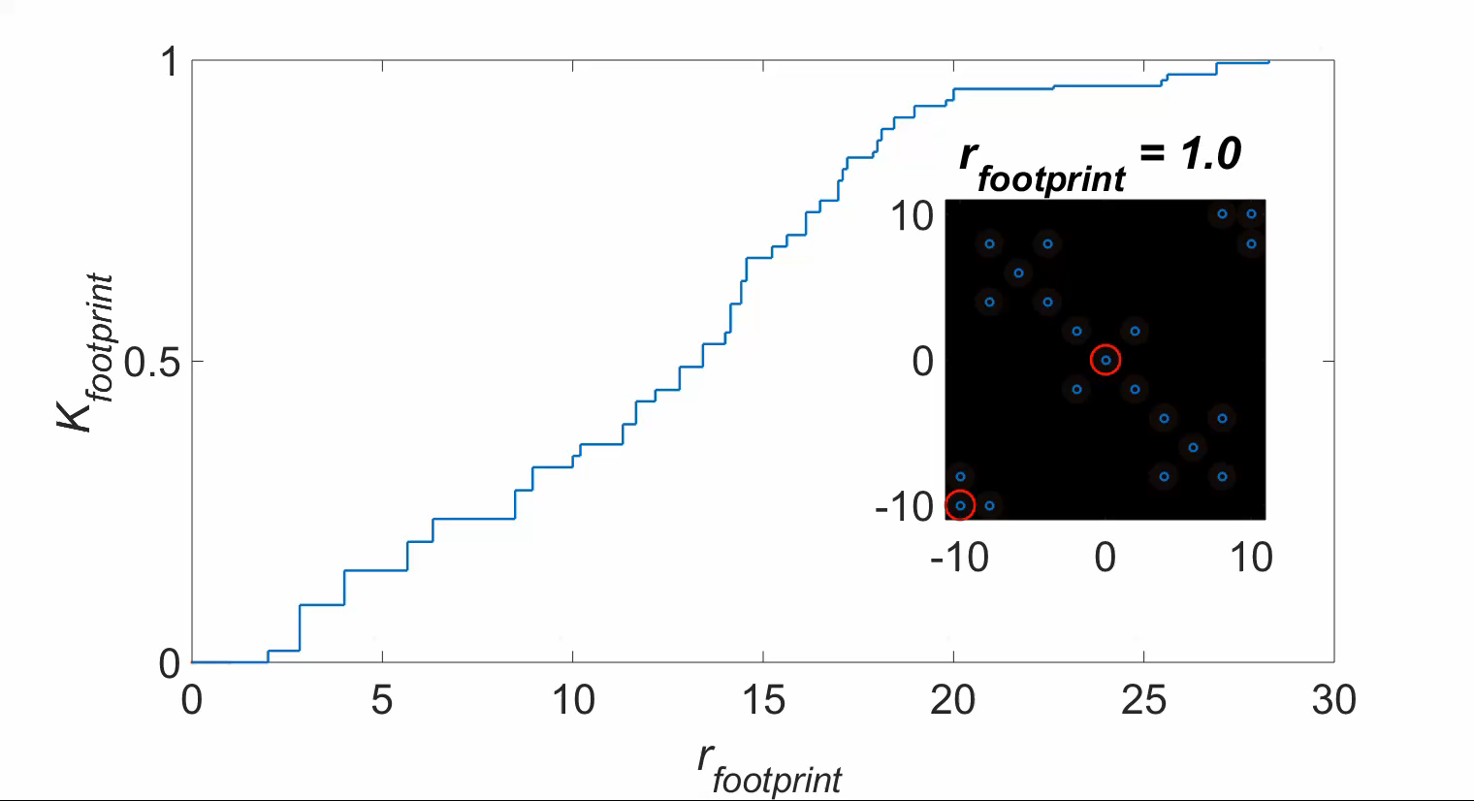
As $r_{footprint}$ grows more sensors recharge simultaneously

Slide 7

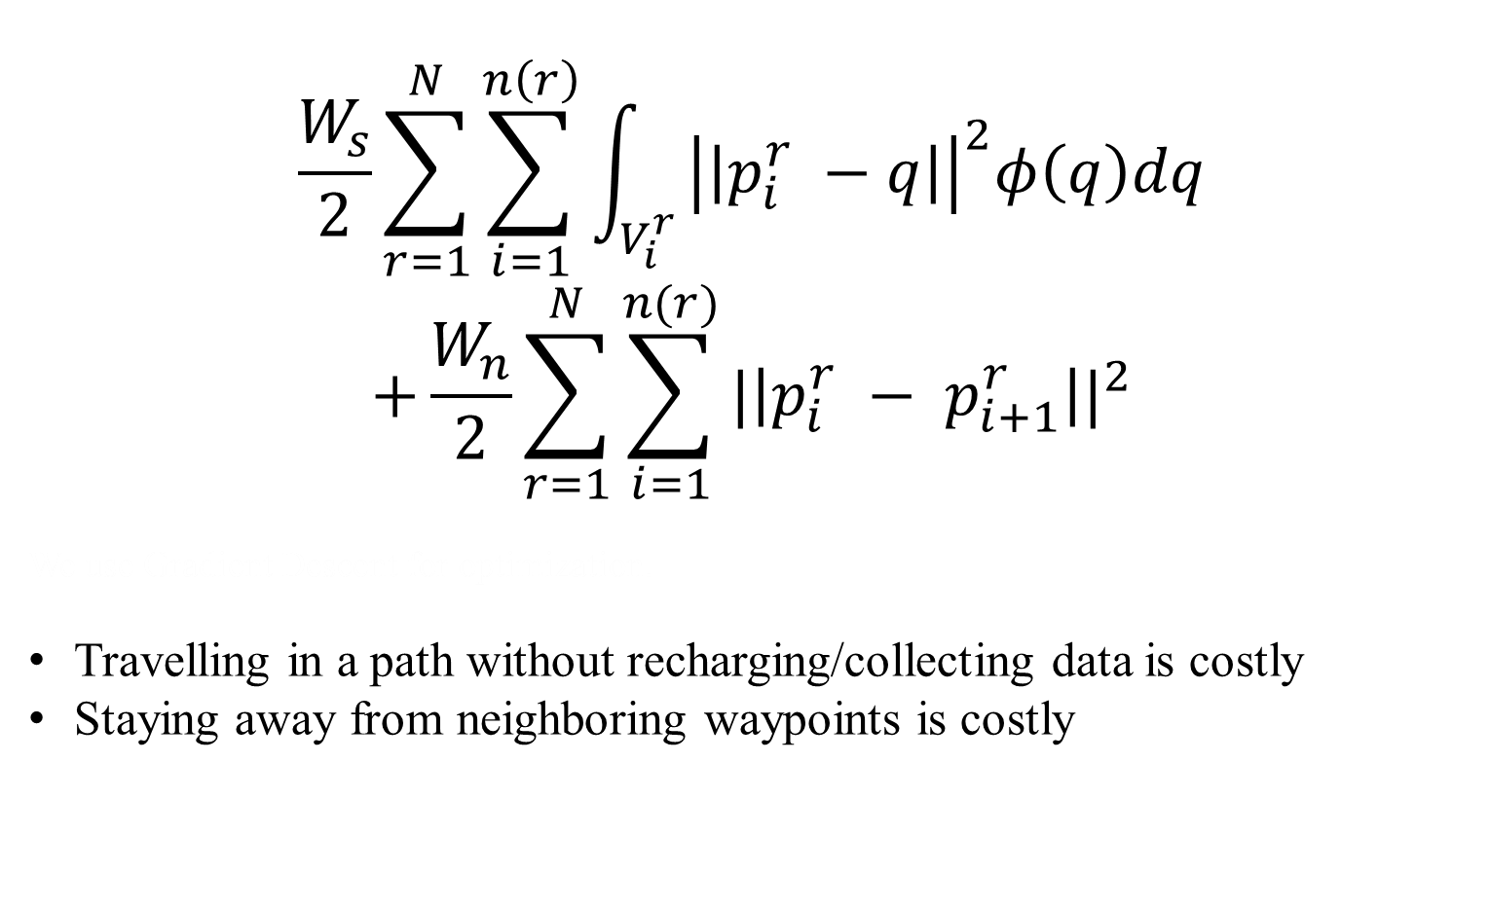
Cost Function to Minimize
$$\frac{W_{s}}{2}\sum_{r=1}^{N}{\sum_{i=1}^{n\left(r\right)}{\int_{V_{i}^{r}}{{\left|\left|p_{i}^{r} −q\right|\right|}^{2}φ\left(q\right)dq}}}$$
$$+\frac{W_{n}}{2}\sum_{r=1}^{N}{\sum_{i=1}^{n(r)}{{|\left|p_{i}^{r} − p_{i+1}^{r}\right||}^{2}}}$$
We use Gradient Descent for optimization.
Travelling in a path without recharging/collecting data is costly
Staying away from neighboring waypoints is costly
H =
$q$ - points on the map
$p_{i}^{r}$ - waypoint i of $robot$ r
$φ\left(q\right)$ - Interesting function
$W_{n}^{}$ and $W_{s}^{}$ are scalar weights

Slide 8
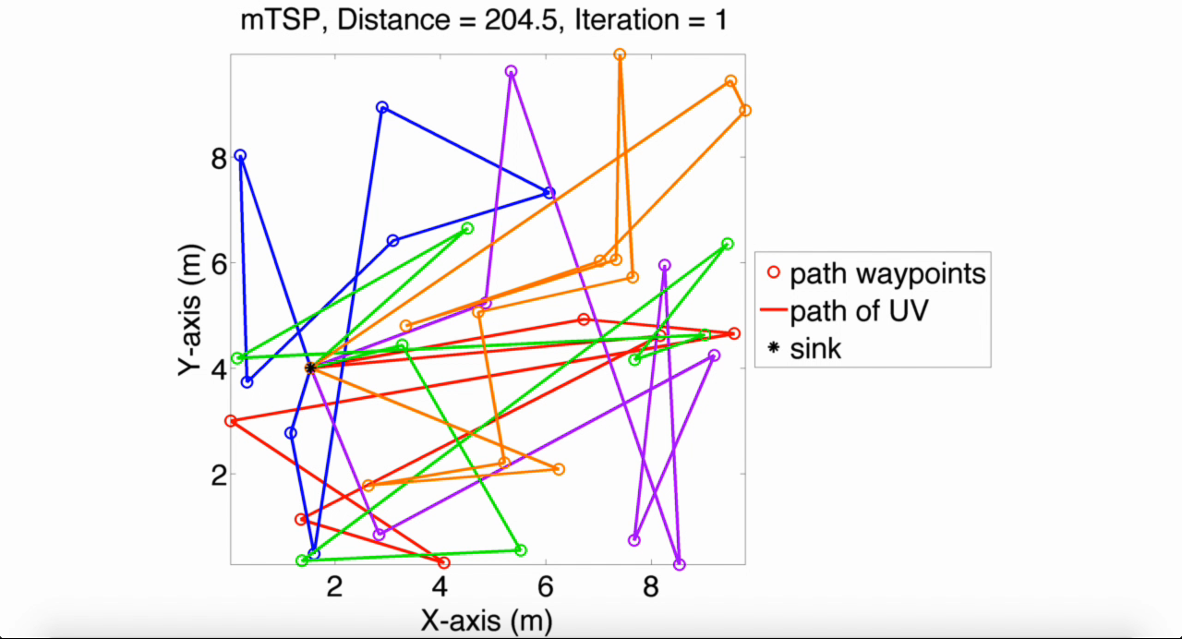
mTSP - (multiple Travelling Salesman Problem)

Slide 9
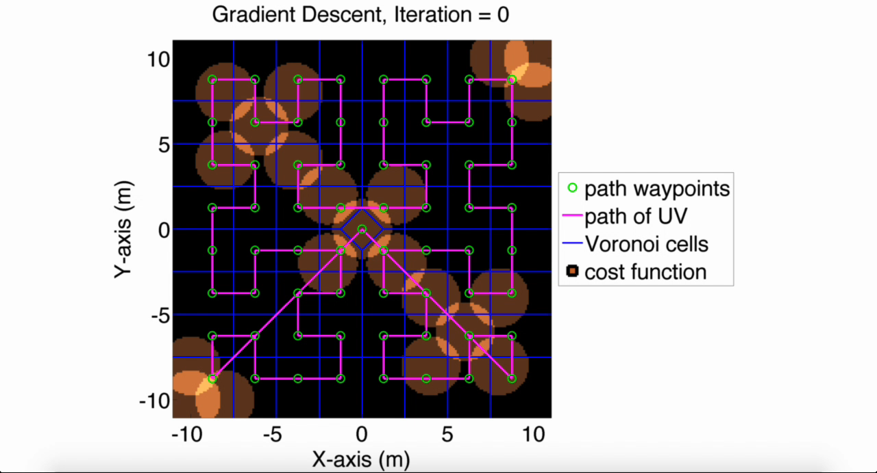

Slide 10
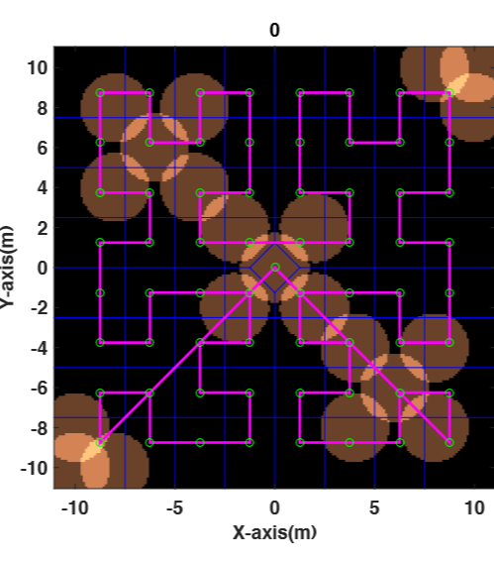
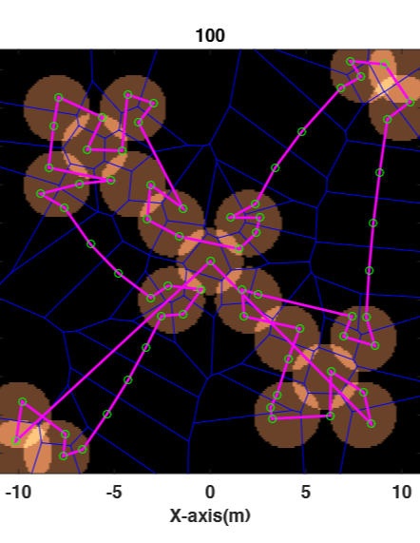
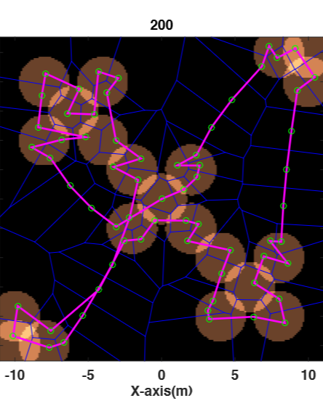
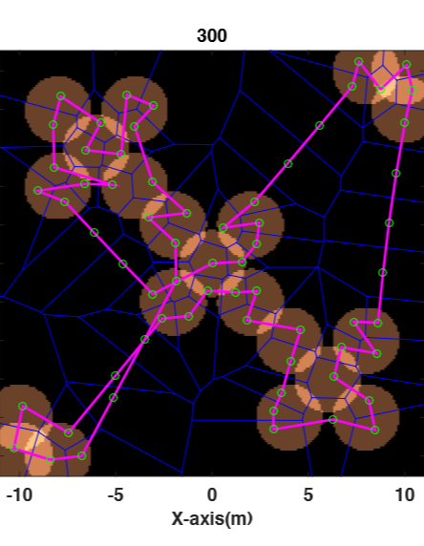
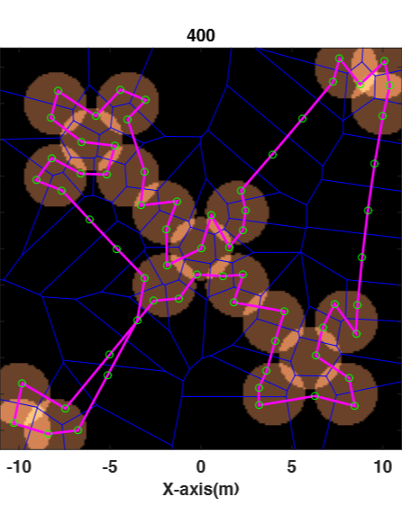
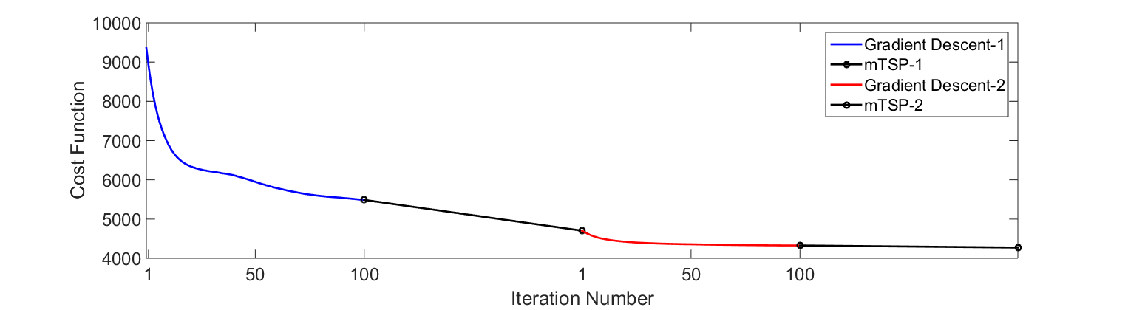
Results with One Robot

Slide 11
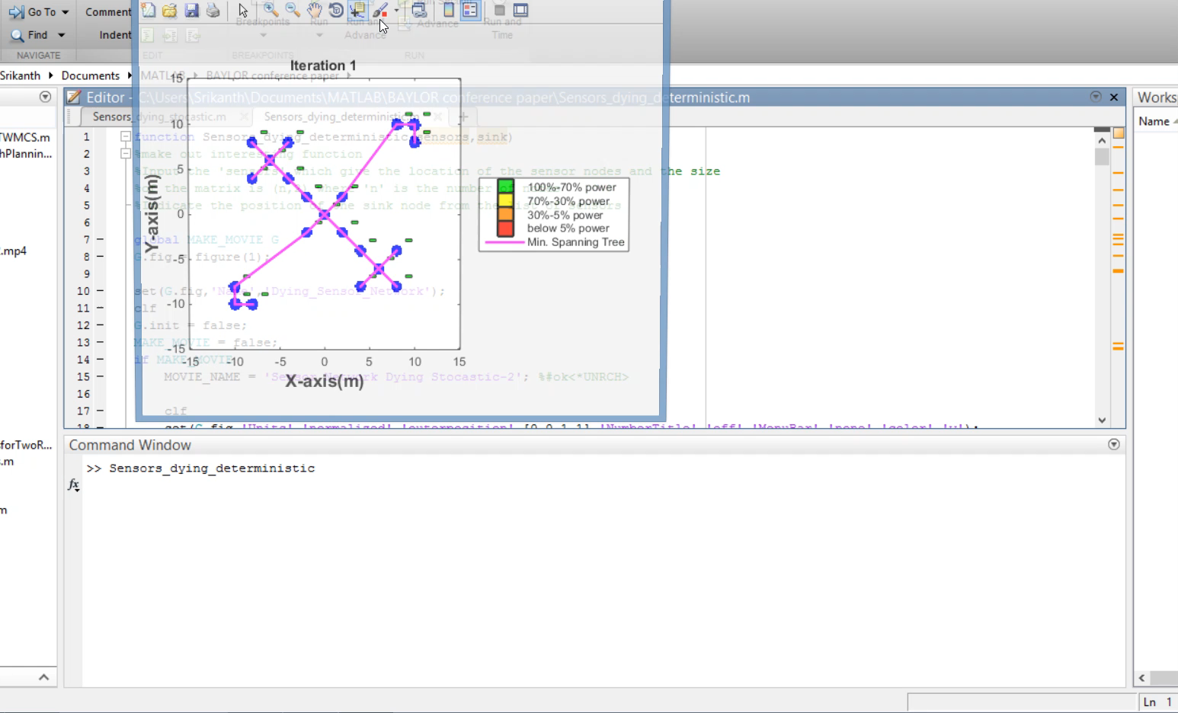
Wireless Sensor Network Dying
Deterministic

Slide 12
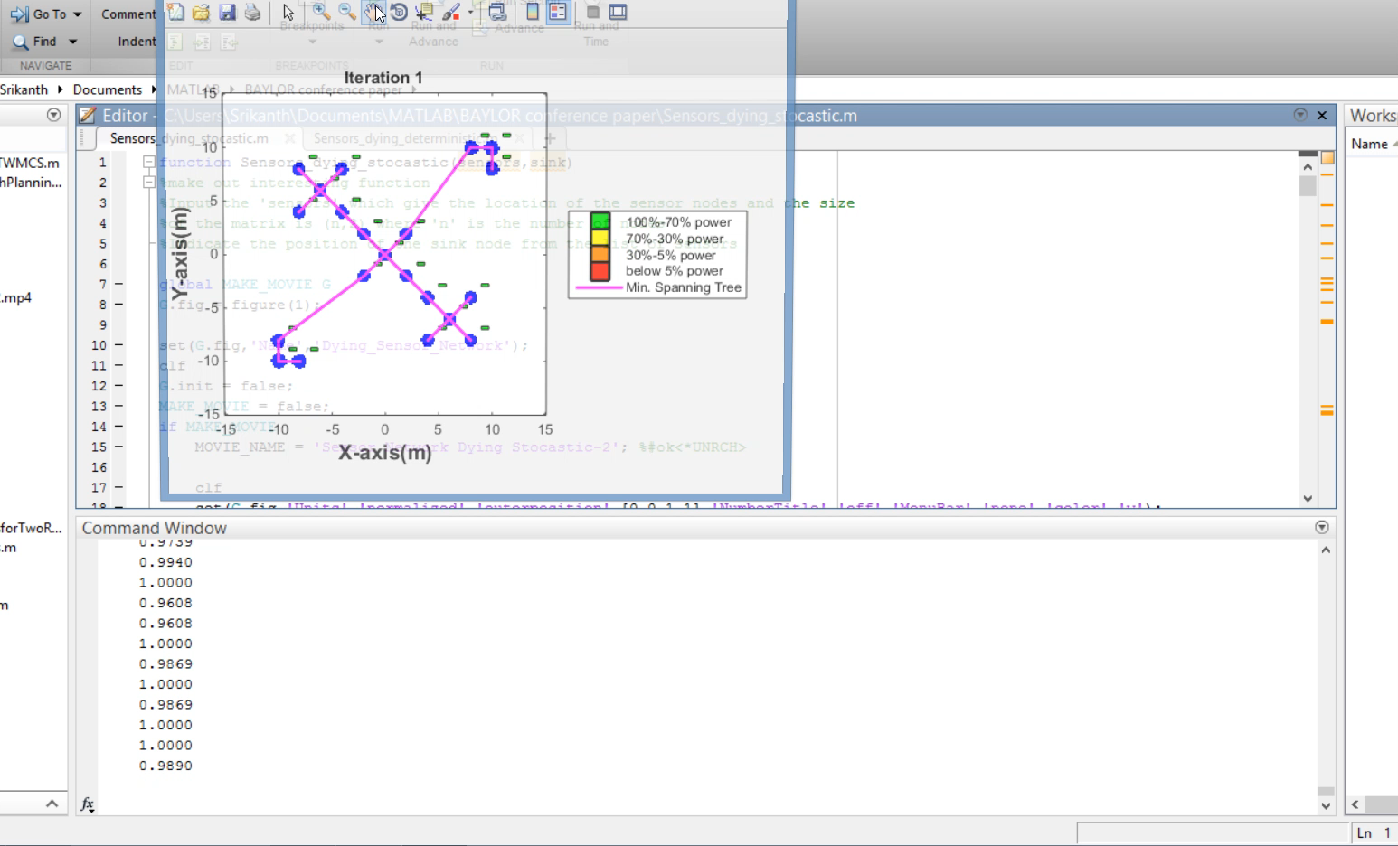
Wireless Sensor Network Dying
Stochastic

Slide 13

POISSON DISTRIBUTION
Calculate the probabilities of various numbers of outcomes based on the mean number of outcomes
The events must be independent
$$\operatorname{Pr}\left(X=k\right)=\frac{λ^{k}e^{−λ}}{\text{k}\text{!}}$$
e is the base of natural logarithms (2.7183) λ is the mean number of outcomes k is the number of outcomes desired

Slide 14
Weeks
2 4 6 8 10 12 14 16
Adapting algorithm with sensors dying (stationary)
Coding and Hardware Implementation using ERA mobile robots
Algorithm for non-stationary sensor nodes
Time Line
Design of Quadcopters
Coding implementation of stationary and non-stationary case using a single quadcopter
Extending implementations with multiple robots and establish communication between individual agents

Slide 15
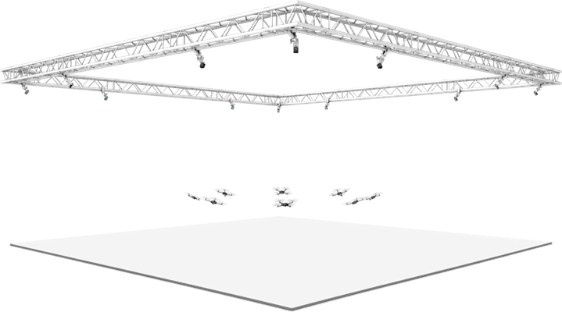
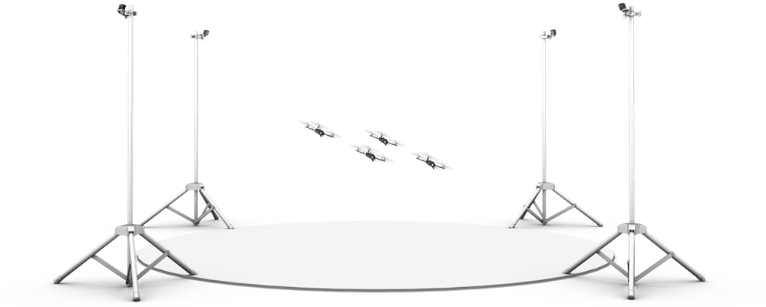
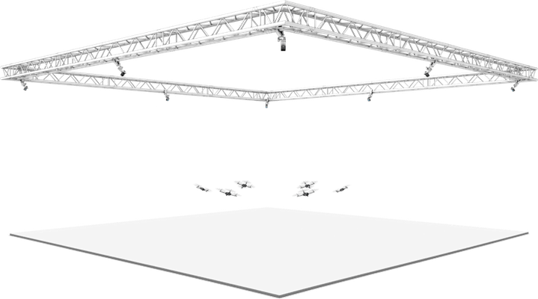

Future Work
Extend simulation to handle non-stationary sensor nodes. UVs modify routes to maintain service
Improve convergence rate by adapting other optimization techniques
Test the algorithm on mobile-robots, eventual implementation on quadcopter swarm
Conclusion
Optimized path-planning for sustaining a WSN with two algorithms:
Gradient descent on cost function (local minima)
mTSP solver (searches for better rearrangements)
Model uncertainties in Sensor Networks
THANK YOU!
QUESTIONS?

